Slide 1

Hydration

Slide 2
What are some “more healthy” beverages you have consumed in the last day or so?

Slide 3
What are some “less healthy” beverages you have consumed in the last day or so?

Slide 4
On a scale of 1-10
(10 being really good), how healthy do you consider your nutrition habits to be in terms of beverages you consume?
Why do you think that is?

Slide 5
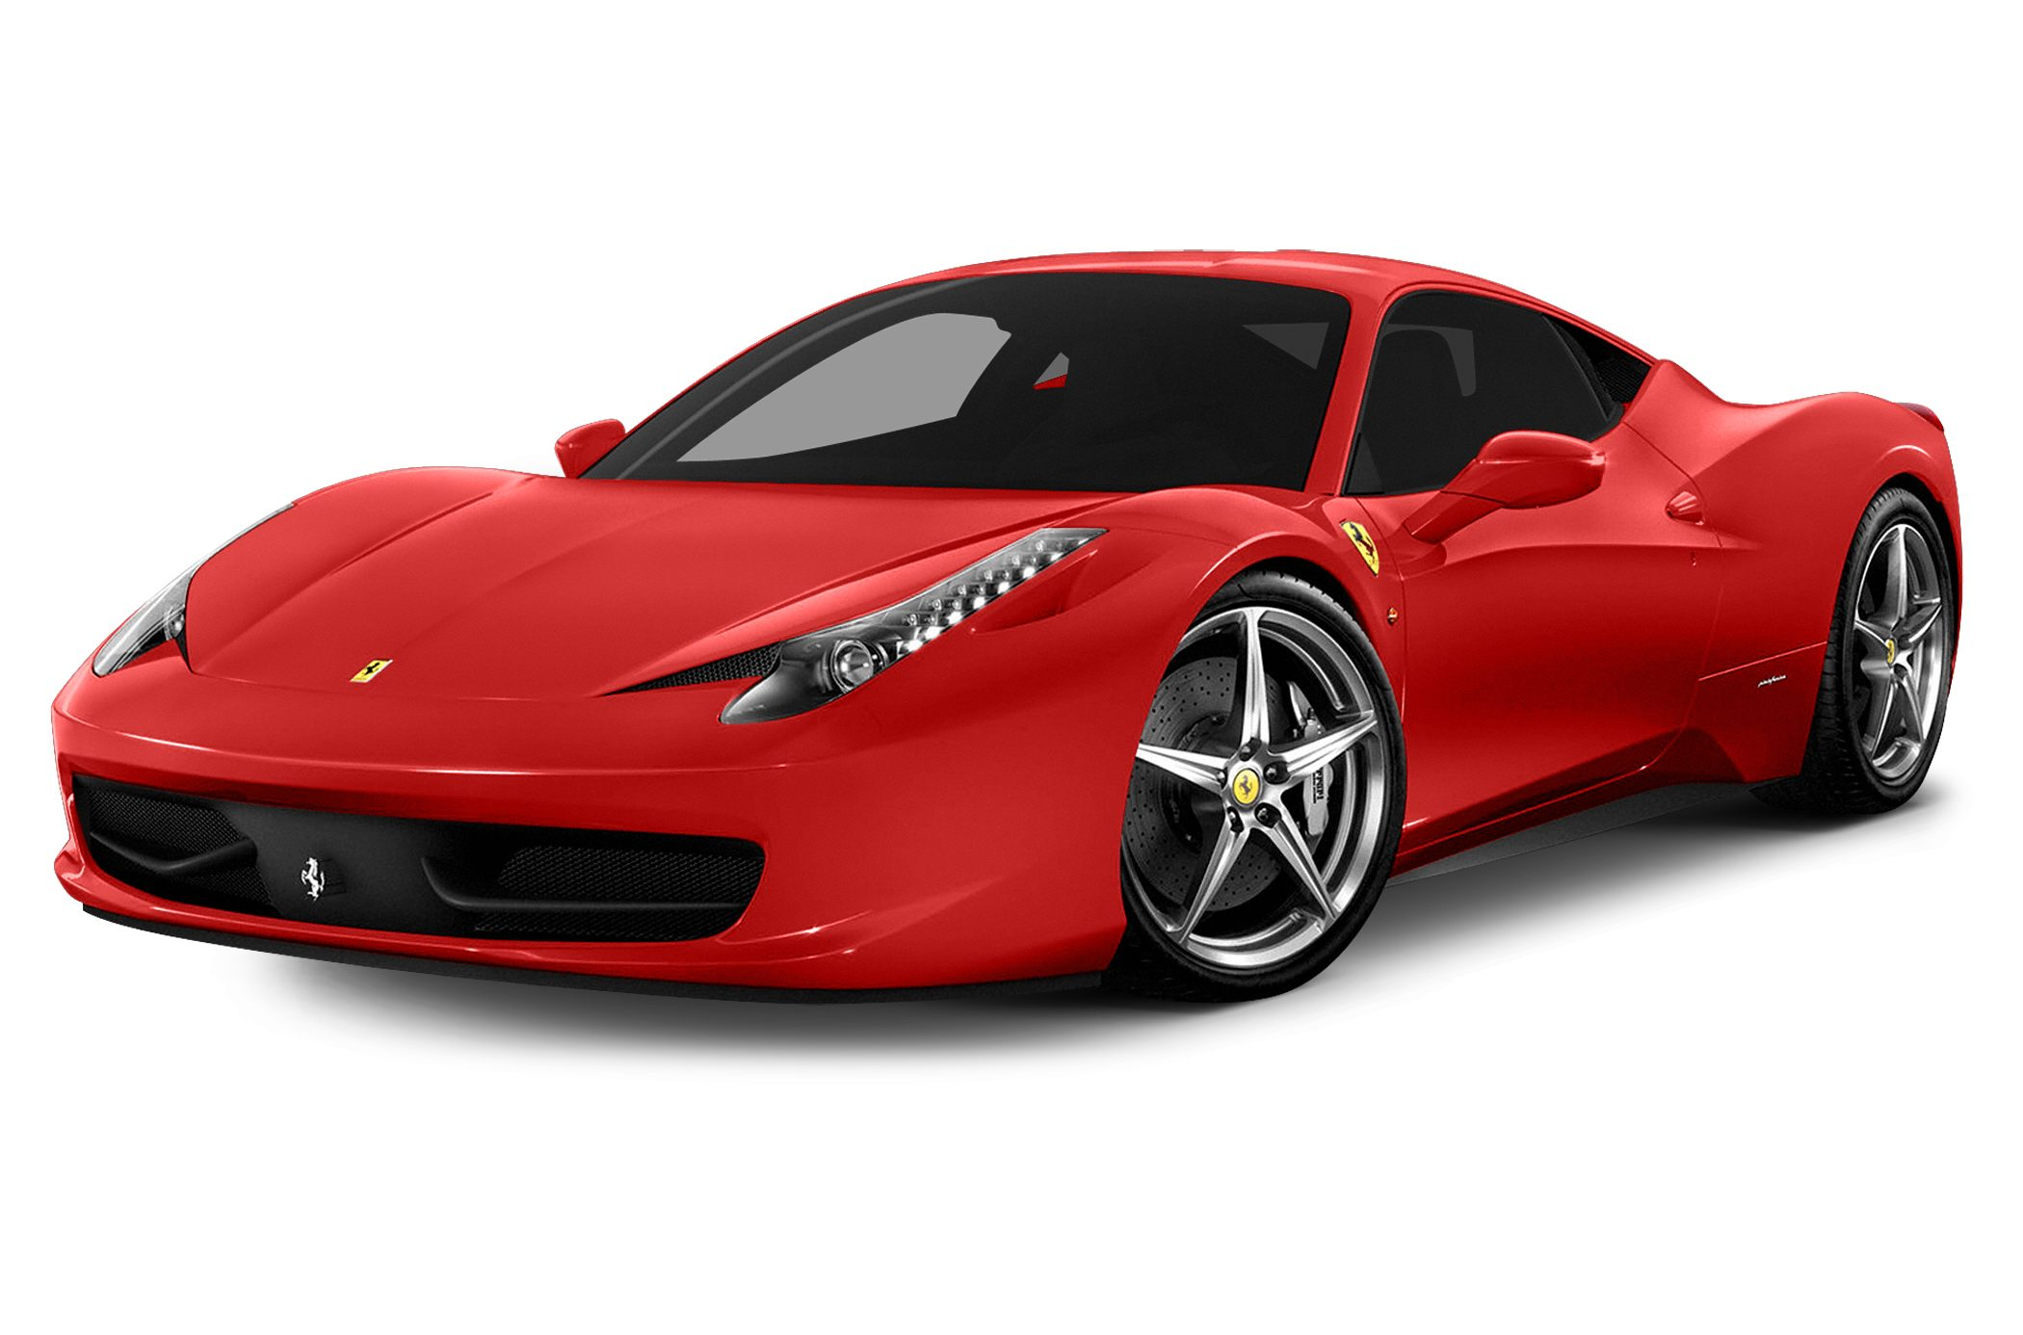
Your body is like a SPORTS CAR

Slide 6
How does nutrition impact your capability of being a healthy teenager?

Slide 7
So, how do I know what to drink?

Slide 8
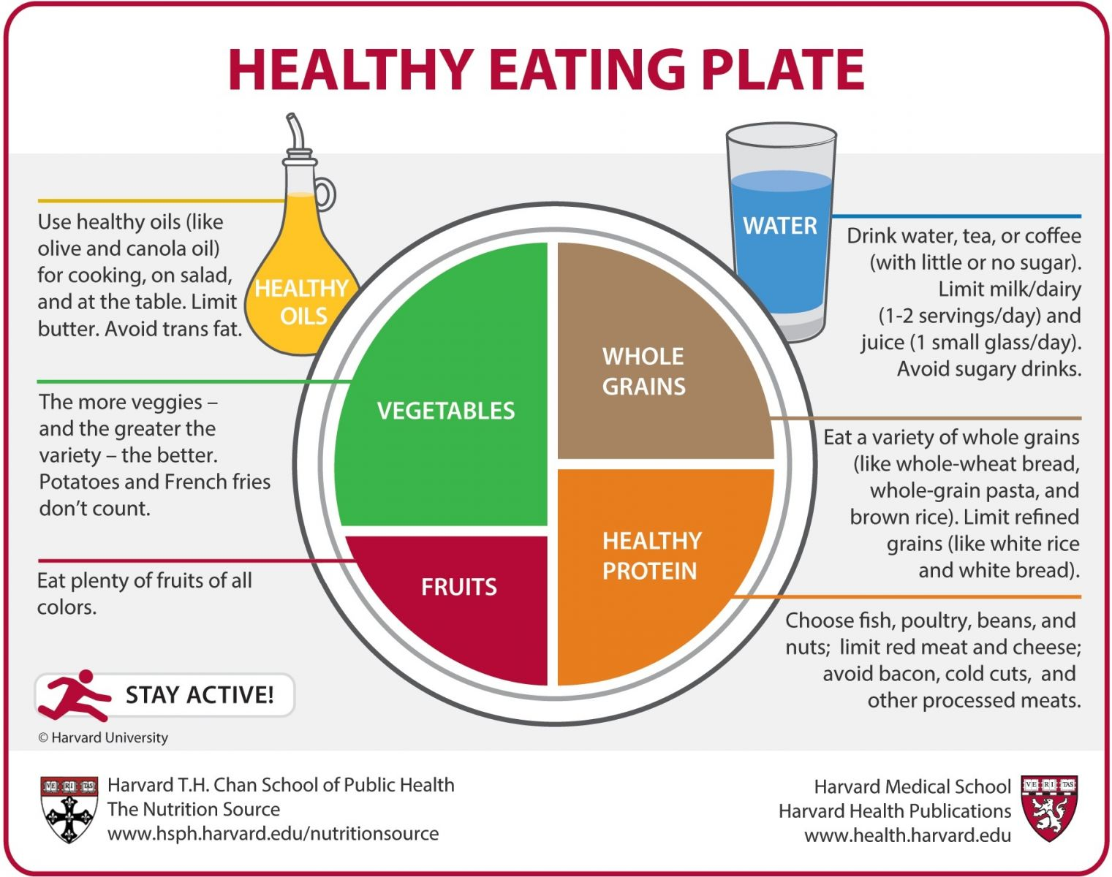
Harvard’s Healthy Eating Plate
Notes:
Source: https://www.hsph.harvard.edu/nutritionsource/healthy-eating-plate/

Slide 9
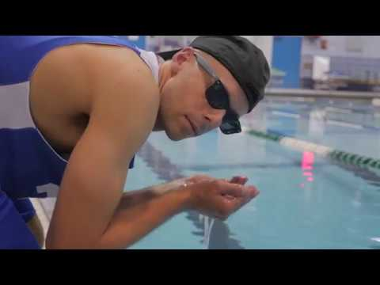
Notes:
See link to view - https://www.youtube.com/watch?v=kcfGCds4u_Q

Slide 10
It makes up 60-70% of our body weight
We need water to: cool our bodies, help w/digestion, absorb & carry nutrients, remove waste & repair the body, and cushion for organs & joints
Our body loses water each day
Skin
Breathing
Urine
Why Drink Water?

Slide 11
Foods like soup, vegetables & fruit (about 20%)
Fruits such as watermelon, grapes, oranges and apples contain a high amount of water.
Veggies such as cucumbers, peppers, lettuce & tomatoes provide a high amount water.
Drinks (about 80%) - healthy drinks include water, milk, 100% vegetable or fruit juice (no more than ½ cup per day)
Which Healthy Foods & Drinks
provide fluids to our body?

Slide 12
14-18 year olds: about 7-10 cups (56-80 oz)
Water should make up most of your fluid intake
How Much Water should you drink Every Day?

Slide 13
When our body does not have enough fluid.
It happens when we do not drink enough, or if we lose too much fluids (physical activity, hot weather, or both)
It can make it difficult for us to focus, decrease physical performance, and over heat (stress on body)
What is Dehydration?

Slide 14
Usually by the time we are thirsty, we are already dehydrated
The color of your urine (dark = drink more fluids)
If dehydrated, you might feel thirsty, tired, cranky, dizzy or light-headed
How do I know If I am Drinking Enough?

Slide 15
Drink beverages with meals and snacks throughout the day
Carry a water bottle so you can drink anywhere
Drink extra fluids before, during, and after physical activity.
Watch for signs of dehydration
Ways to Avoid Dehydration

Slide 16
Drinks & Added Sugar
Can you guess how much
sugar is in each beverage?
Notes:
You can print the slides without the answers (all odd numbered slides 17-46) and have students walk around the room to view them and make their guesses using the handout “Drinks and Added Sugar”. Or, you could project the slides to the screen and have them guess as you go through the list while using the same handout.

Slide 17
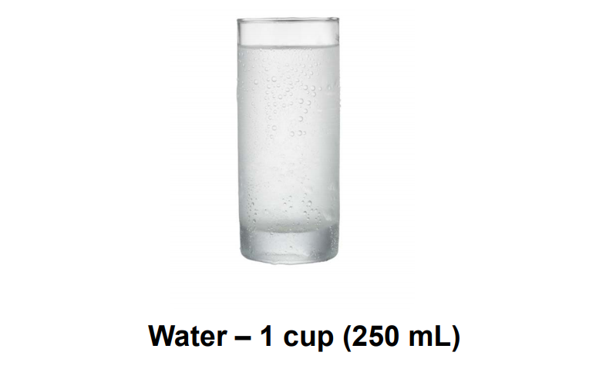

Slide 18
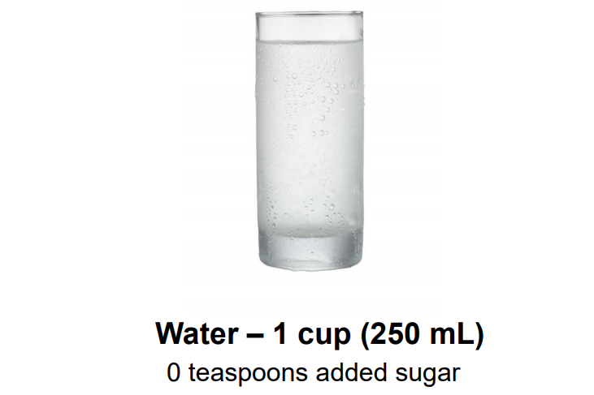

Slide 19
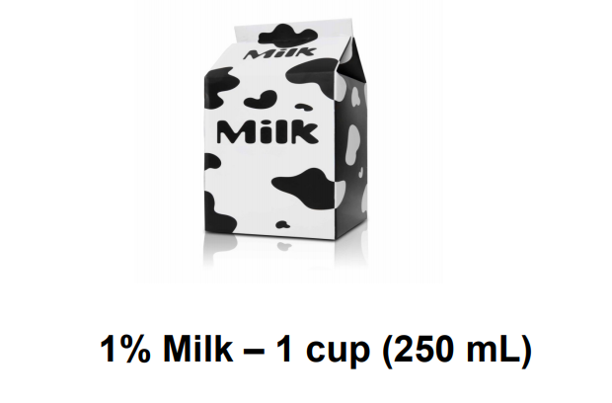

Slide 20
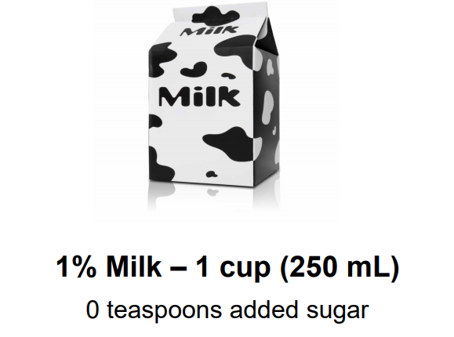

Slide 21
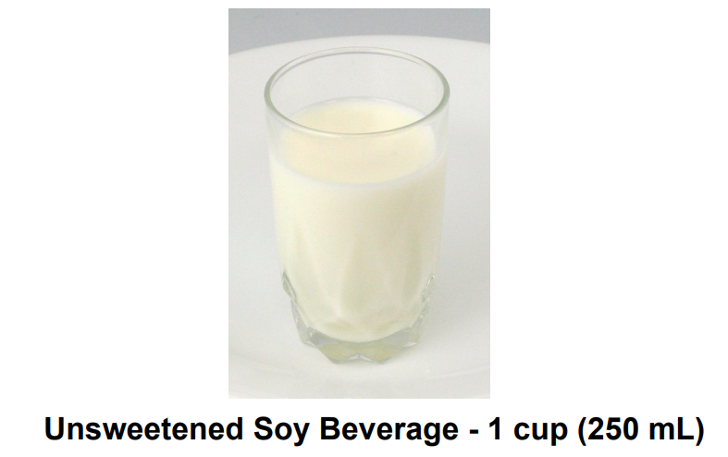

Slide 22
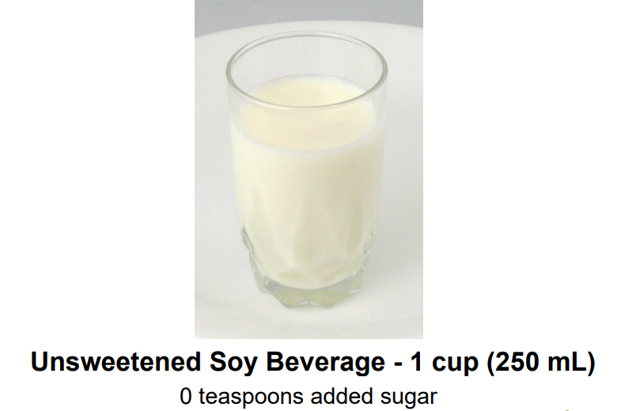

Slide 23
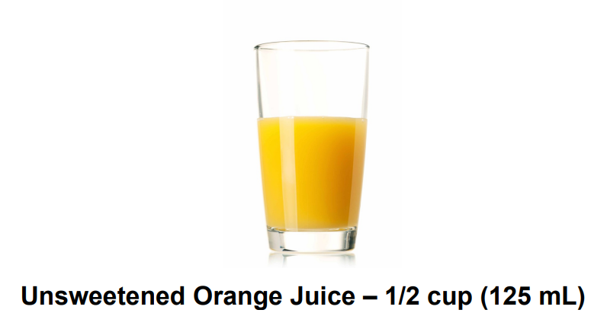

Slide 24
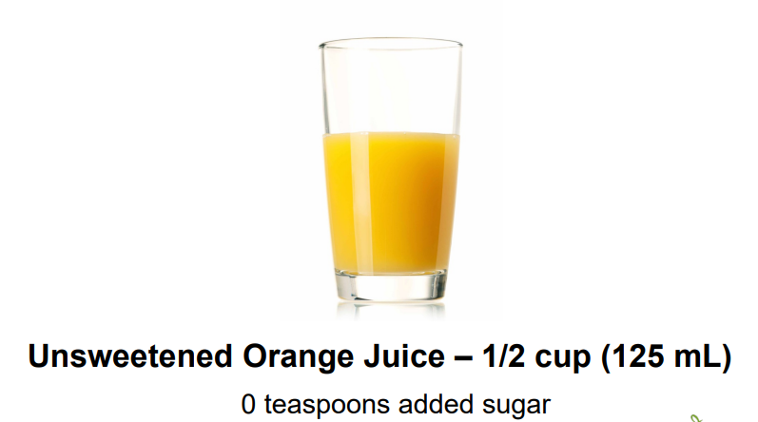

Slide 25
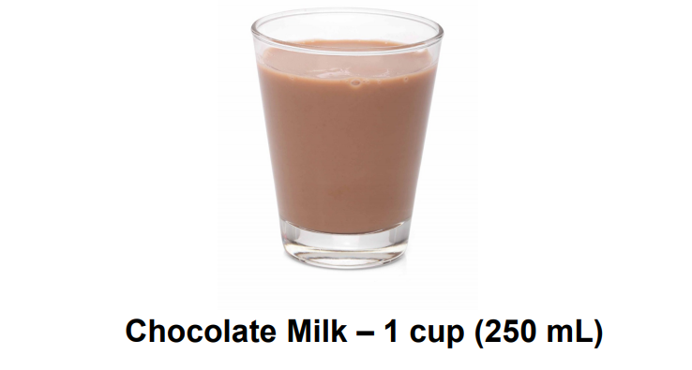

Slide 26
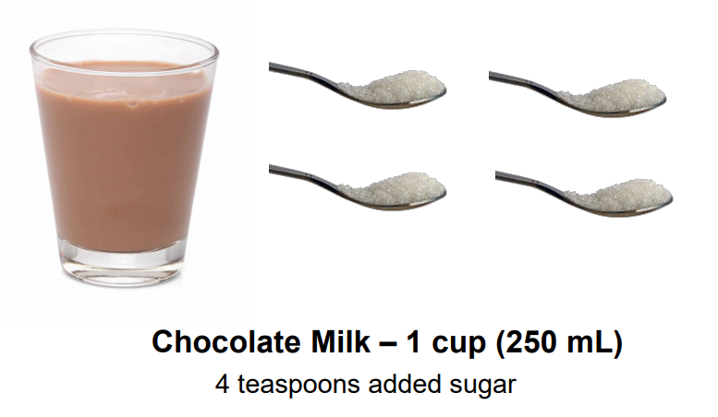

Slide 27
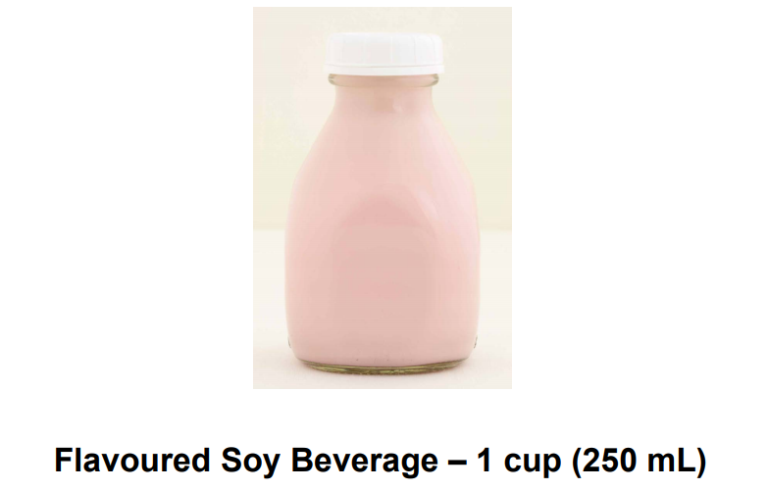

Slide 28
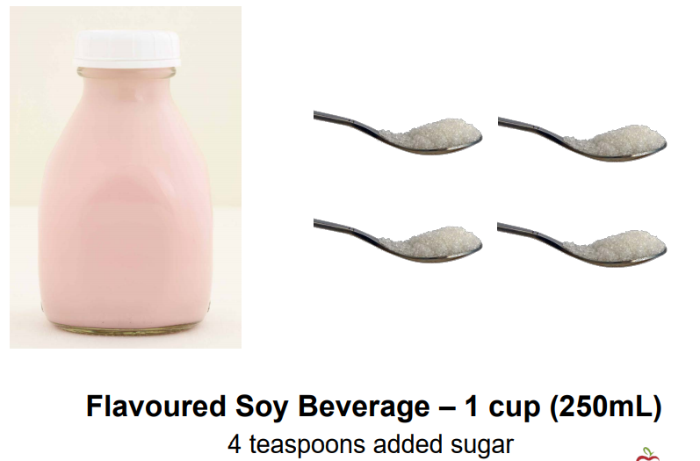

Slide 29
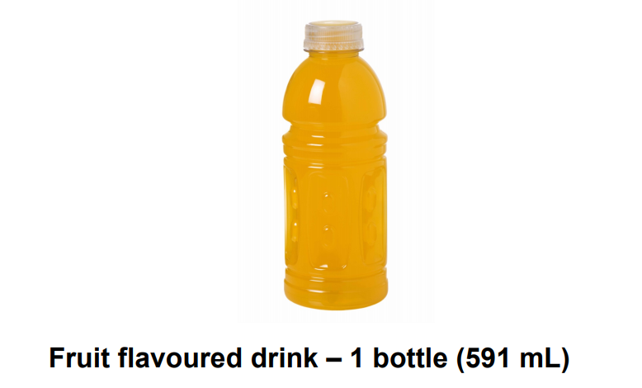

Slide 30
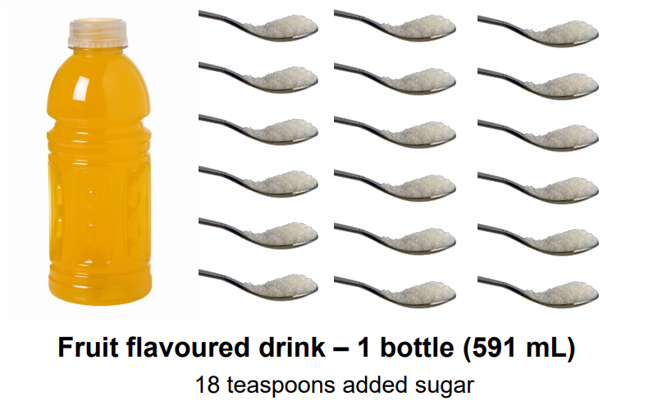

Slide 31
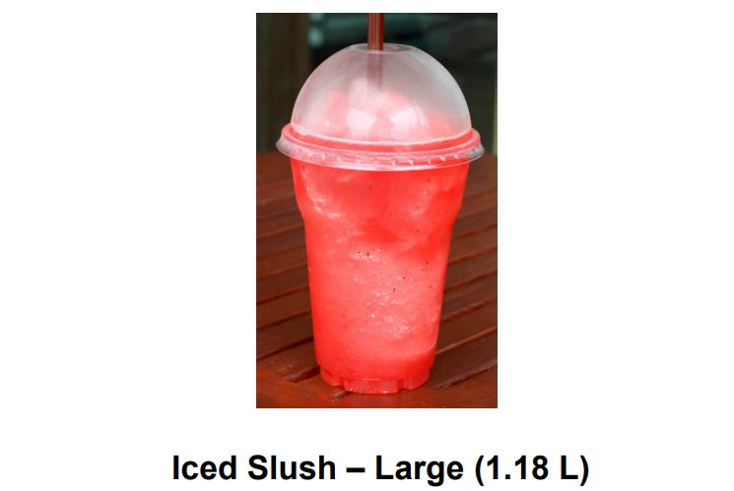

Slide 32
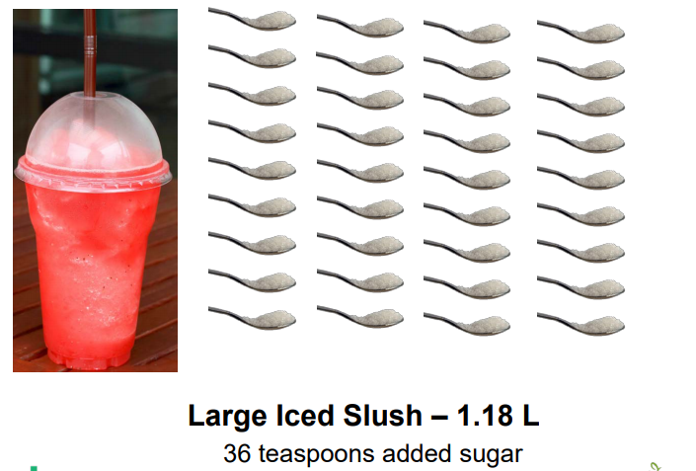

Slide 33
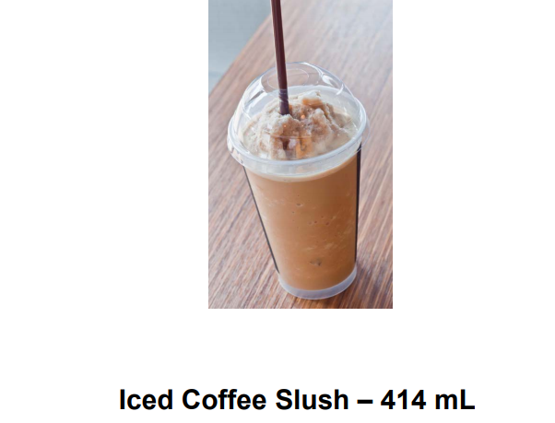

Slide 34
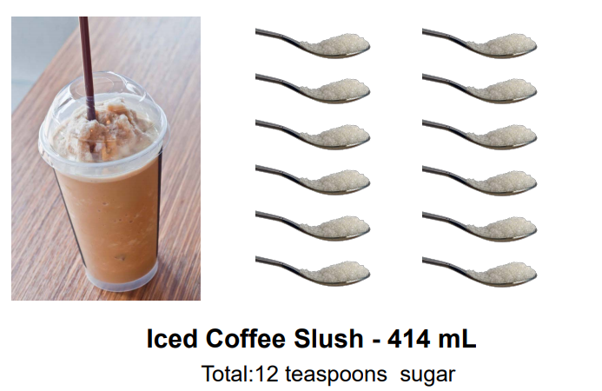

Slide 35
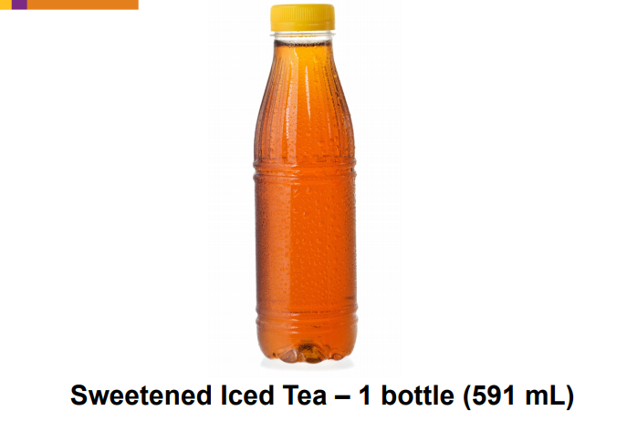

Slide 36
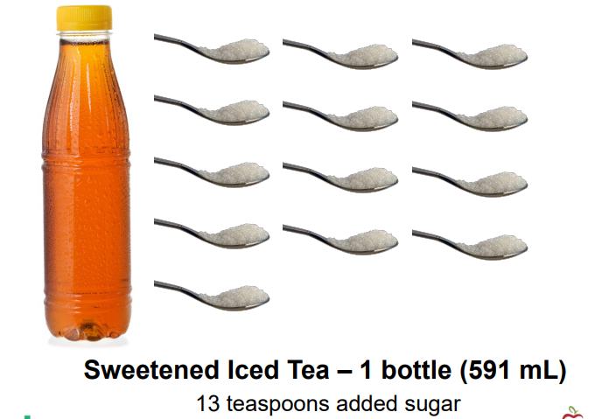

Slide 37
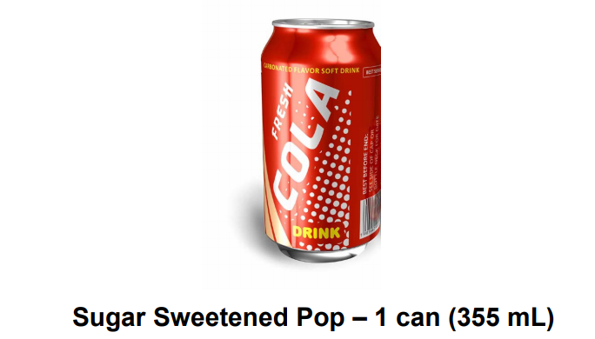

Slide 38
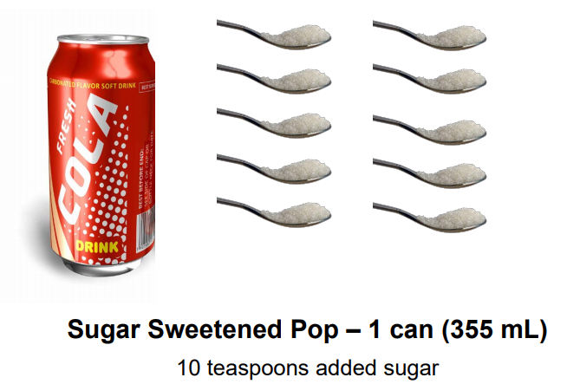

Slide 39
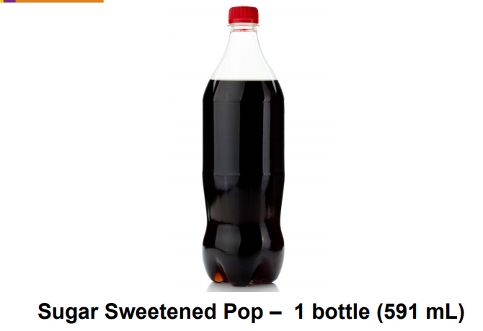

Slide 40
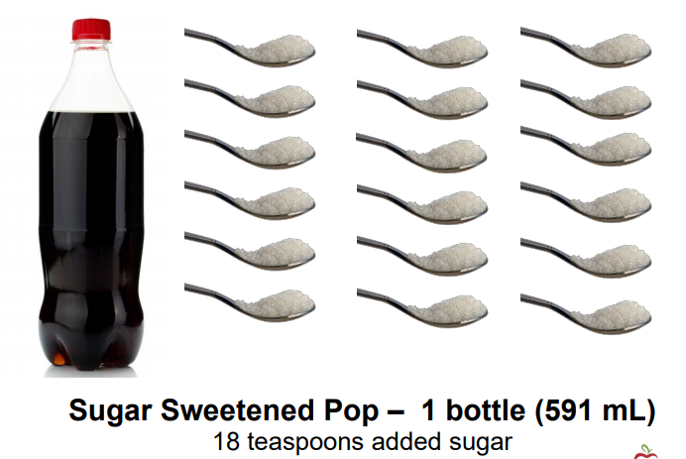

Slide 41
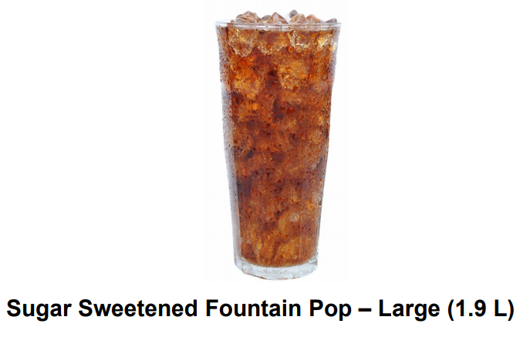

Slide 42
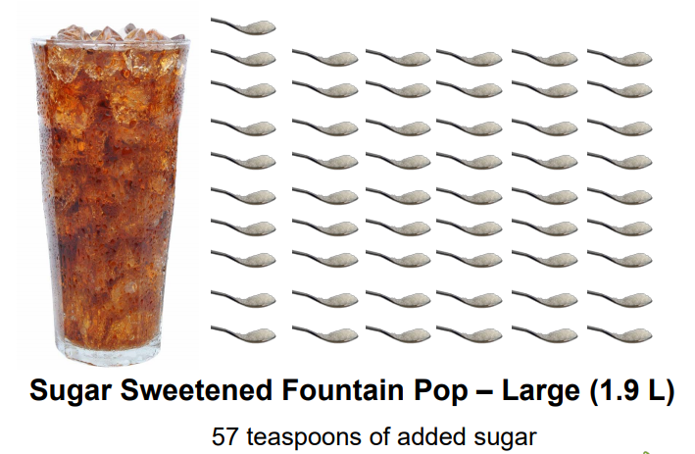

Slide 43
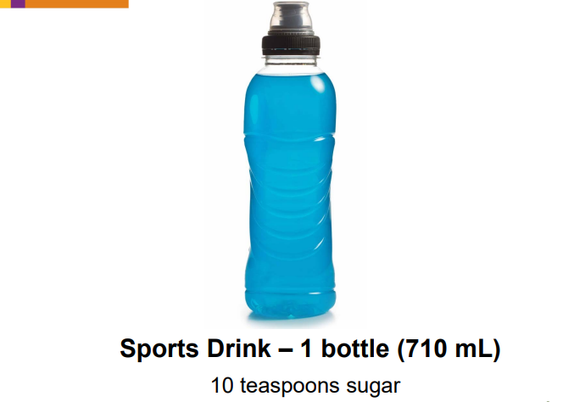

Slide 44
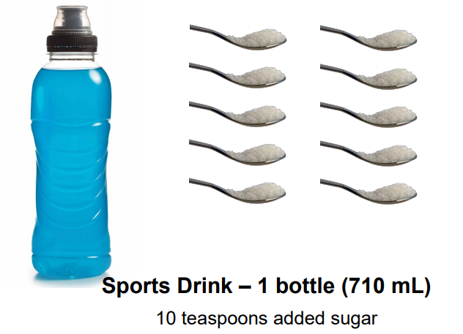

Slide 45
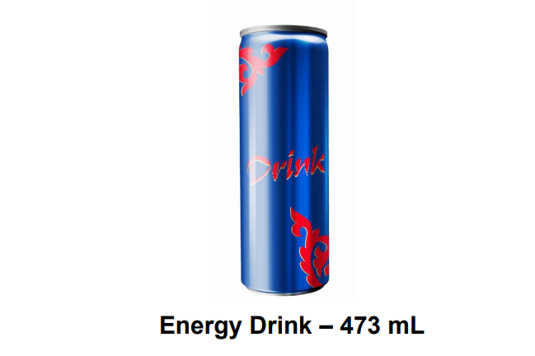

Slide 46
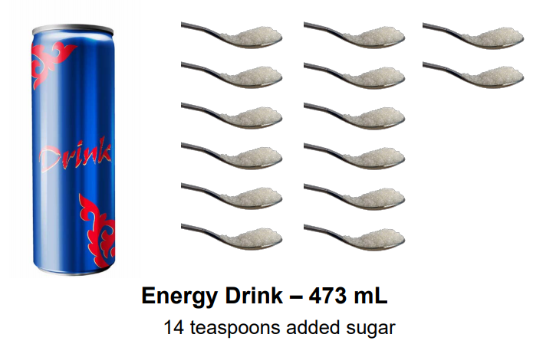

Slide 47
What are the top 5
influences on your nutrition?
In other words, what has caused you to eat the way you do?

Slide 48
Parents
Peers
Culture
Advertising
Family Traditions
Values & attitudes
Education
School/Class
Cost
Convenience
Time
Sports
Taste
Weight control
Religion
Pregnancy
Travel
Limited Choice
Some Examples
Might Include
Notes:
Others could include: neighborhood, health condition, social outings

Slide 49
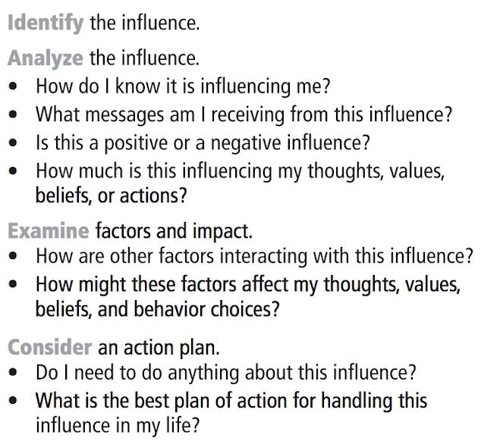
Step 2 - Present Steps of Skill
Notes:
Image taken from the web resources associated with Lesson Planning for Skills-Based Health Education

Slide 50


Influence
Step 3 - Model the Skill
Message:
Influence
Influence
Message:
Message:
______________
Your Name
Health Topic
____________
Influence
Influence
Complete this at the end…
What is one action you can take to positively improve your sleep hygiene?
Message:
Message:
Notes:
Analyzing Influences – Potential Health Topics: Body Image, Nutrition, Use of Technology, Substance Use, Peer influence, Sexual Behaviors
Create a web with your name and health issue in the center. Each spoke signifies an influence in your life (i.e. family, peers, social media, etc.). Identify at least 5 influences AND the message that you receive from each of those influences about the particular health topic. Finally draw a line connecting the source to yourself – the thicker and bolder the line, the more powerful you feel that influence is on your decisions and behaviors about this topic. *Idea inspired by Lindsey Armbruster

Slide 51
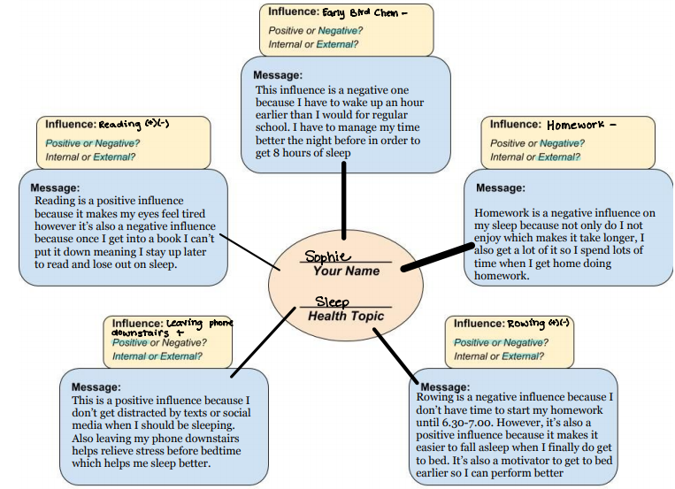
Step 4 - Practice

Slide 52
Water Wit Activity - Why Drink Water?

